Slide 1

Use “Cover Story” with your team to develop your vision & mission statements
Formula for Writing Vision Statements
5 years from now, [name] will be a successful, [describe team/organization] by providing [describe products/services] to [customers.]
Within the next [number] years, develop/grow [name] into a successful [describe organization/unit] increasing [factor] to [quantity] by [date] providing [products/services] to [customers.]
Adapted from: Reid, Susan, Ph.D., “How-to Write a Great Business Vision Statement”

Slide 2
Formula for Writing Mission Statements
Why do you exist? – The problem being solved/needs
Formula: To increase, decrease, eliminate, prevent, or improve + the condition or problem to be changed
What activities do we do to address the needs?
Formula: To provide…by or through...
What principles or beliefs guide our work?
Formula: Our core values that our co-workers share and practice
Where do you do this work?
Formula: Geographical region, place, customers/stakeholders
Adapted from: Reid, Susan, Ph.D., “How-to Write a Great Business Vision Statement”

Slide 3
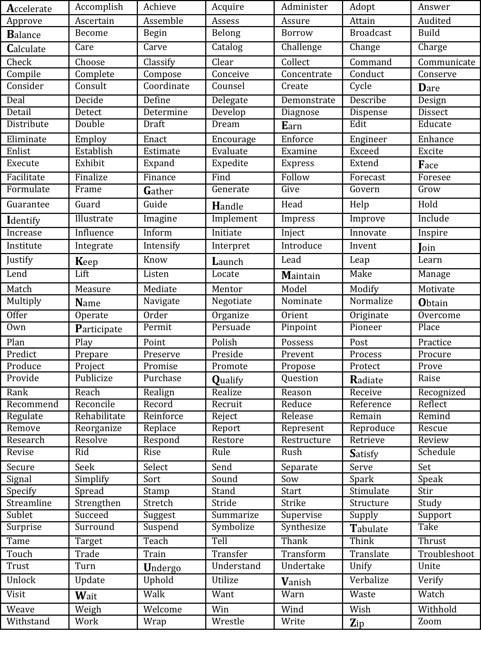
Strategic Verb List for Writing Vision & Mission Statements

